Slide 1
EDA CAPSTONE PROJECT ON Airbnb booking analysis

Slide 2
Team Members-
1.Raja Chowdhury
2.Kashif Kamran
3.Sandipan Das
4.Aman Jain
5.Sucheta Ghosh

Slide 3

Airbnb, Inc. is an American company that operates an online marketplace for lodging, primarily homestays for vacation rentals, and tourism activities. Based in San Francisco, California, the platform is accessible via website and mobile app. In general, Airbnb is cheaper than hotels because Airbnb does not have to pay for the overhead costs of a hotel or the general management of such a large operation.

Slide 4
Understanding the data:
As the objective is clear the data needs to be analysed , this process starts with understanding your data. After collection of the hotel booking data , we come to understand the following things:
The dataset has 48895 rows and 16 columns:
16 variables are as follows:
1. id- refers to the id of the hotel.
2. name- refers to the hotel name.
3.host id- refers to the id of the hotel incharge.
4.host name- refers to name of the hotel incharge.
5.Room type- The type of the room is divided into three categories i.e private room, shared room and entire home (which means the entire hotel is booked).
6.Price- refers to the cost of the room per night in dollars.

Slide 5
7.Minimum nights- refers to the minimum number of nights spent at that hotel.
8.

Slide 6
Data Processing
Data processing requires cleaning of data and preparing it for further analysis. Our cleaning process involved the following parts:
1.We Observe that there are some outliers for price and minimum_nights. Other columns such as number_of_reviews and calculated_host_listings_count are skewed toward right, so we need to transfer them into categorical variables.
2. As we can see there are some Null Values in host_name, name , last_review and reviews_per_month so will simple drop the rows corresponding to the missing values in those column.
3. we found Null Values are for those properties which doesn't have any reviews. so will replace all the Null values of review_per_month with zero ('0') and drop the last_review as column has very high Null Values and negligible relevence with our problem set for EDA.
4. We can clearly see the total of eleven entries need to be drop whose price is 0 so going forward excluding those entries having price = 0

Slide 7
5. We did not found any pleasing correlation between the numerical variables except number of reviews and reviews per month.

Slide 8
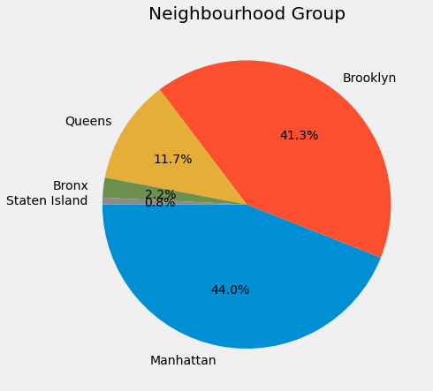
Bookings in neighbourhood.
We can see that in the neighbourhood group most of the bookings are done in Manhattan followed by Brooklyn.

Slide 9
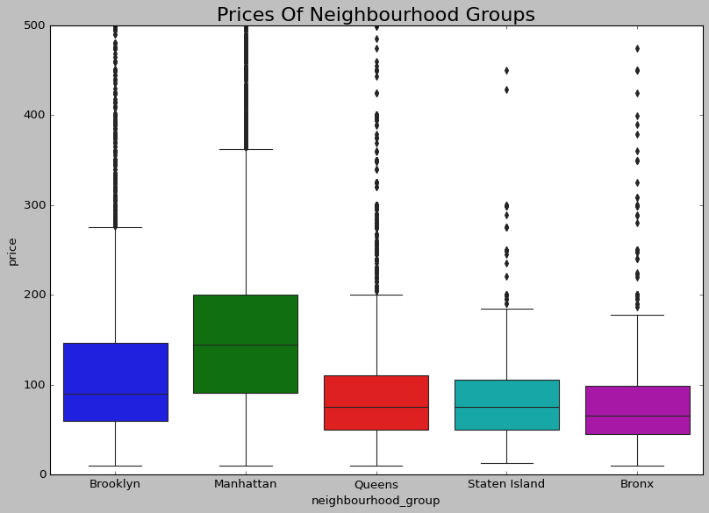
Price of hotels in different neighbourhood groups
The above graph shows that Manhattan has the highest mean price followed by Brooklyn and Queens.

Slide 10
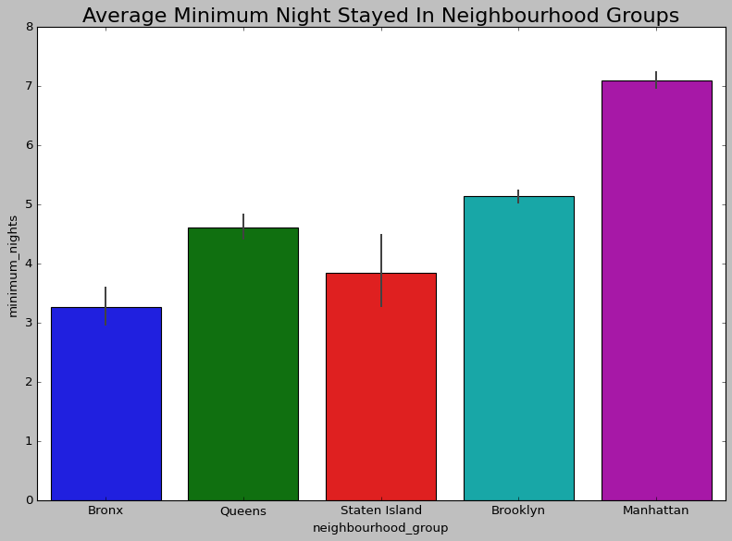
Average minimum nights stayed in neighbourhood groups
From the above figure we can see that Manhattan has the highest number of average staying of minimum nights followed by Brooklyn because these two places has the highest number of bookings.

Slide 11
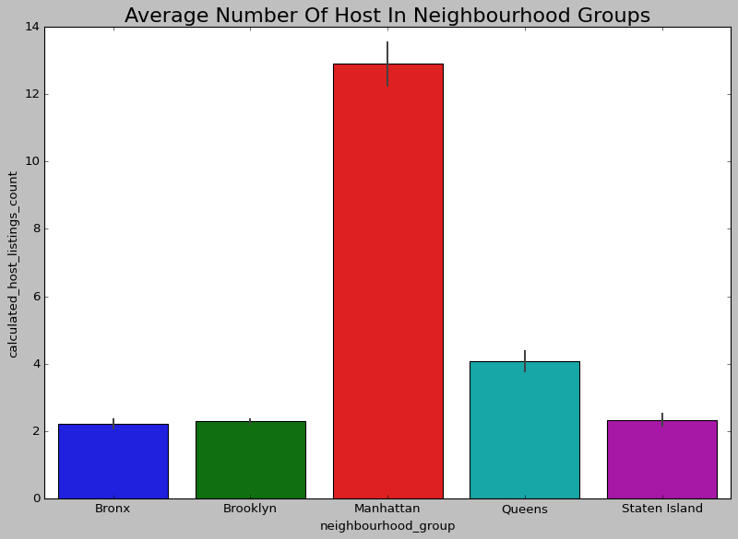
Average number of host in neighbourhood groups
From the above graph we can figure out that Manhattan has the highest number of average host followed by Queens.

Slide 12
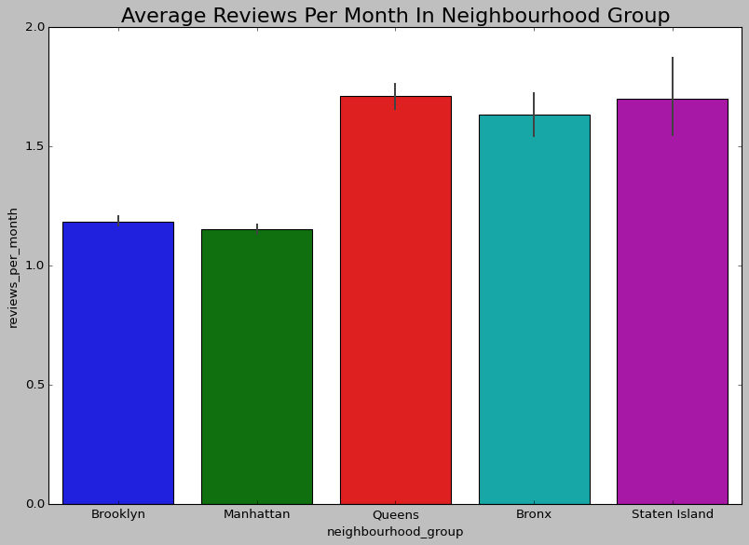
Average Reviews per month in neighbourhood groups
We can figure out from the above graph is that Queens has the highest number if average reviews per month followed by Staten Island.

Slide 13
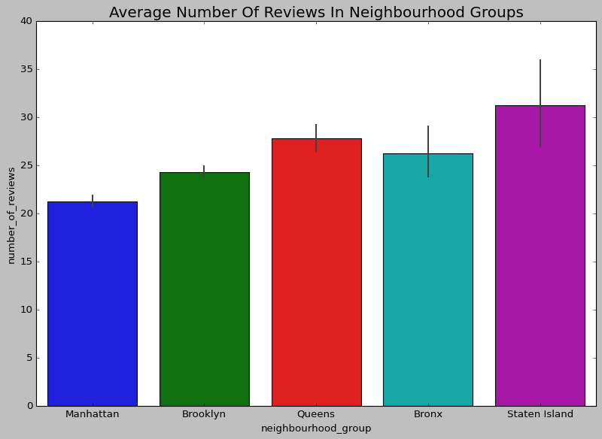
Average number of reviews in neighbourhood groups
From the above graph we can figure out that Staten Island has the highest number of average reviews followed by Queens.

Slide 14
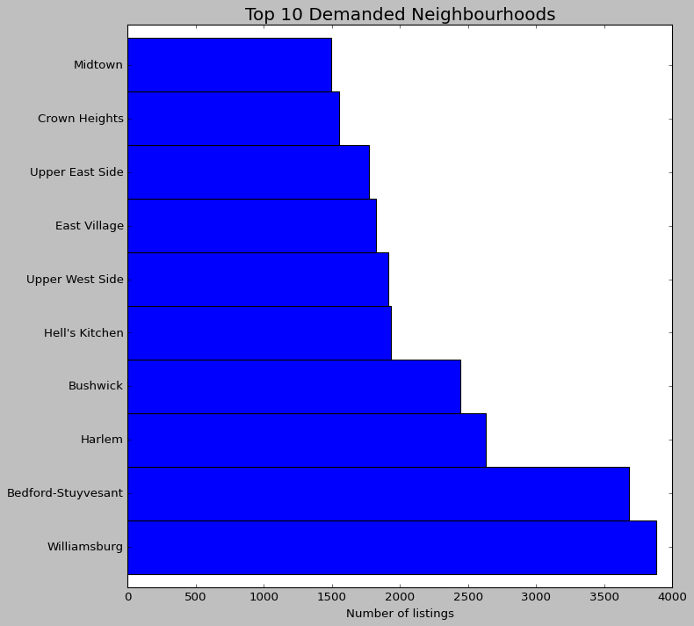
Top 10 Demanded hotels in neighbourhood
From the above graph we can figure out is that Williamsburg followed by Belfort Stuyvesant has the highest demand and both these hotels are located in Brooklyn . So we can figure out that Brooklyn is one of the demanded places in the neighbourhood.

Slide 15
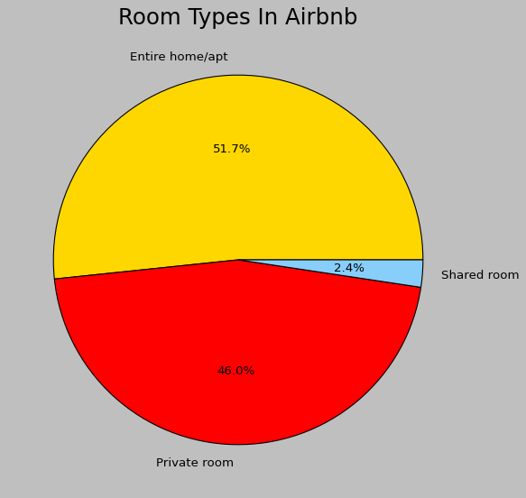
Room types in airbnb
From the above graph we can see that Entire home/apt rooms are more in number as compared to the other two room types which says that tourist or family visits are more than official visits.

Slide 16
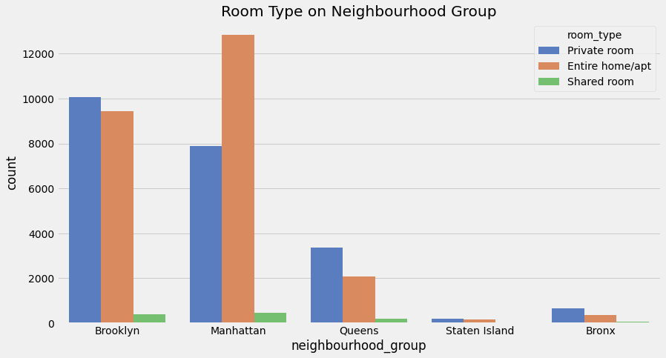
Availability of type of rooms in neighbourhood group
From the above graph we can figure out that entire home/ apt was booked most of the times followed by private room. As stated in the previous slide we can figure out that there are more number of tourist or family visits as compared to official visits.

Slide 17
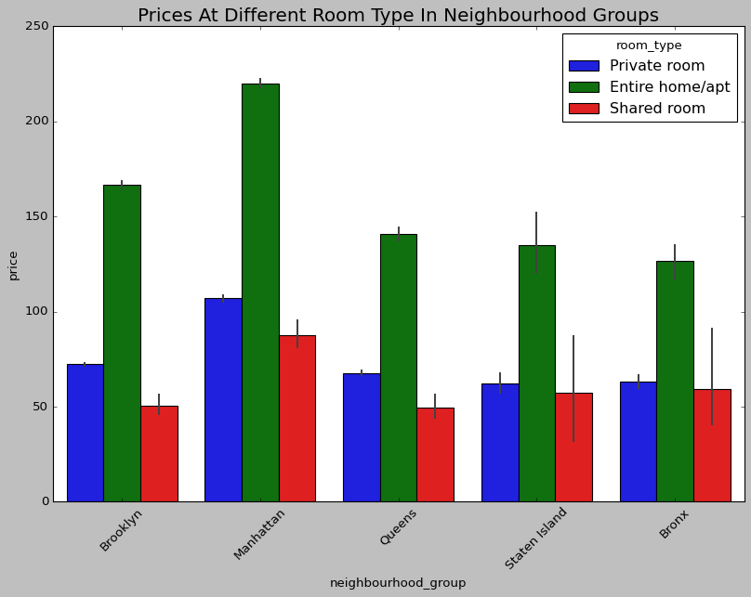
Comparison of prices of different type of rooms in neighbourhood groups
From the above graph we figure out that price of Entire home/ apt was higher in all neighbourhood groups followed by private room. This shows that the demand of entire room/apt was more as compared to the other two types of rooms.

Slide 18
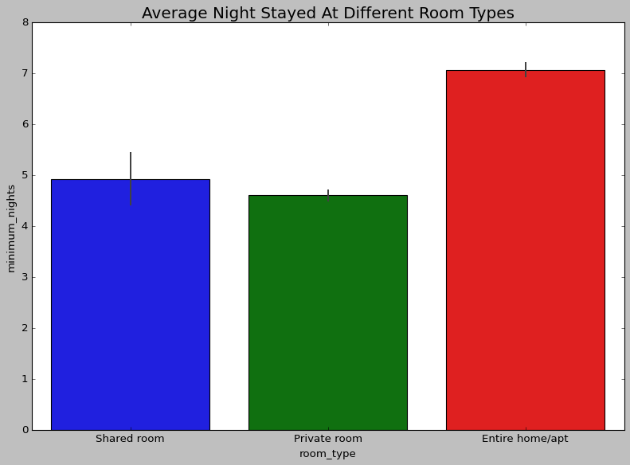
Average nights stayed at different room types
The observation is similar to that in the previous graphs i.e entire home/apt night stayings are more as compared to the other two room types as there are possibilities of family and tourist visits to be more than that of visits regarding official purpose.

Slide 19
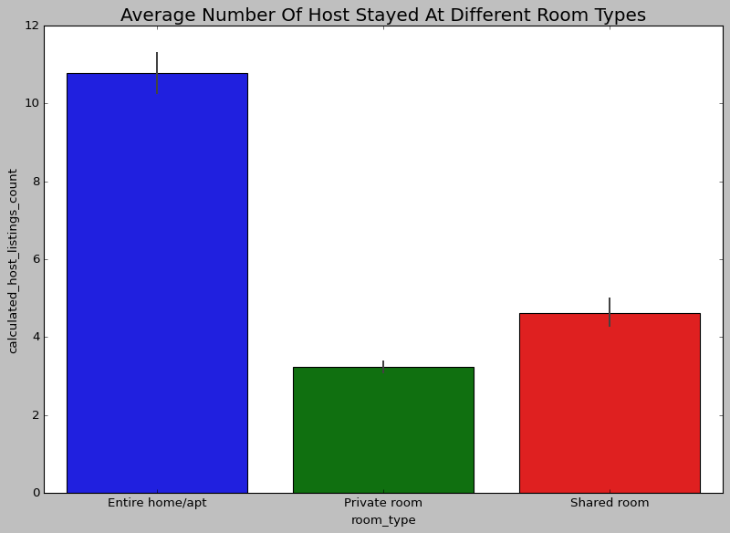
Average number of host stayed at different room types
Hosts i.e guests preferred entire home/apt more than other rooms . It can be said that these guests might be travelling with family or friends rather than travelling alone.

Slide 20
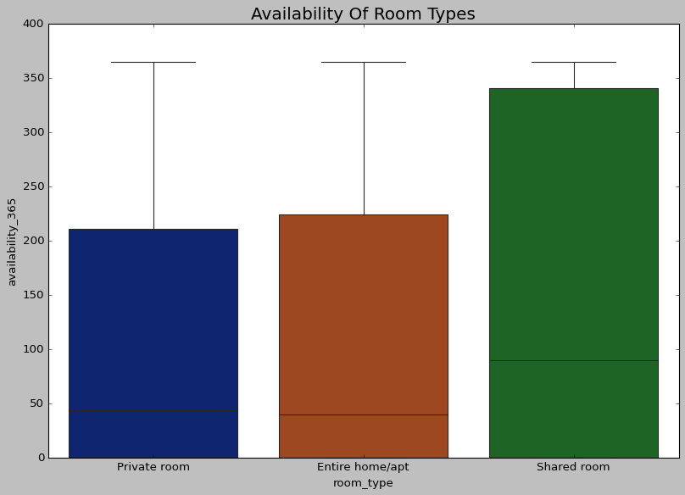
Availability of room types
The above graph shows the availability of room types and it can be inferred that shared room availability was more than the other two types of room. This is because the bookings of the shared room done were less as compared to the other room types.

Slide 21
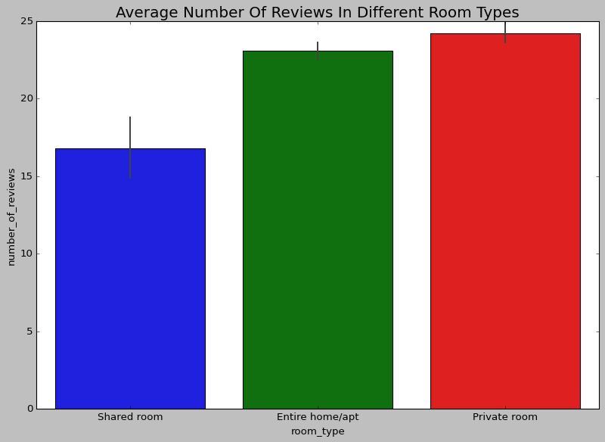
Average number of reviews in different room types
We can see that reviews for private room was more as compared to the room of other two types.

Slide 22
